Slide 1
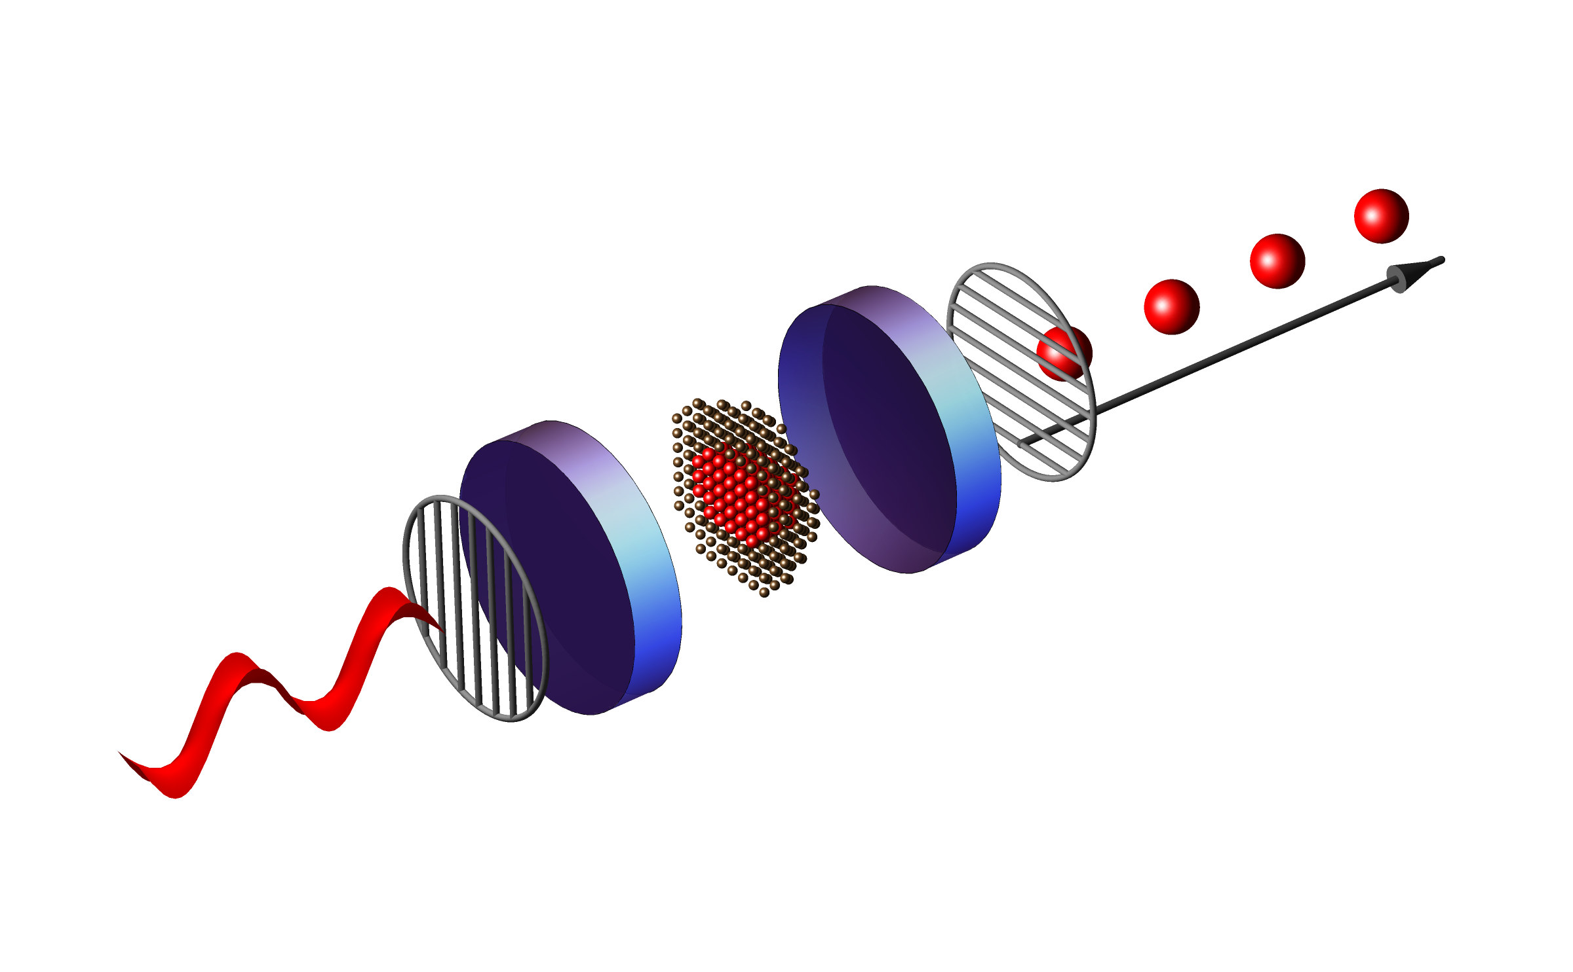
The effect of temporal jitter on single photon indistinguishability
Andrea Maccarinelli 5/16/2025

Slide 2


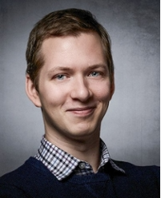
Daily Supervisor:
Mio Poortvliet
Main Supervisor: Dr. Wolfgang Löffler
Second Supervisor: Evert van Nieuwenburg

Slide 3
What is the main goal of my project ?
Boost Single photon indistinguishability
Study the features of the excitation pulses

Slide 4
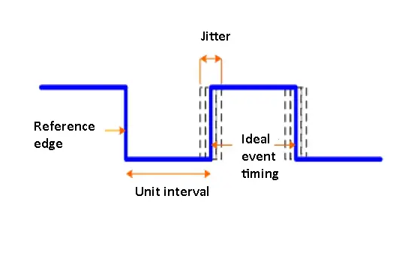
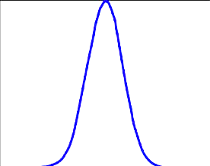
What is the Jitter of a Signal ?
Random Source
Systemic Source
https://www.testandmeasurementtips.com/wp-content/uploads/2017/08/jitter-waveform.jpg
Rev. Sci. Instrum. 95, 054703 (2024); doi: 10.1063/5.0191289

Slide 5
Implementing the Study in Our Setup
Sets the delay
Sends trigger signal
Clock
FPGA
Pulse compressor
Quantum Dot
CW Laser
EOM
EOM

Slide 6
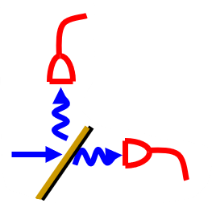
Current Focus – Part I: Hanbury Brown–Twiss on Excitation Pulses
Clock
FPGA
Pulse compressor
SNSPD
Beam Splitter
CW Laser
EOM
EOM
Start/Stop
Timestamps

Slide 7
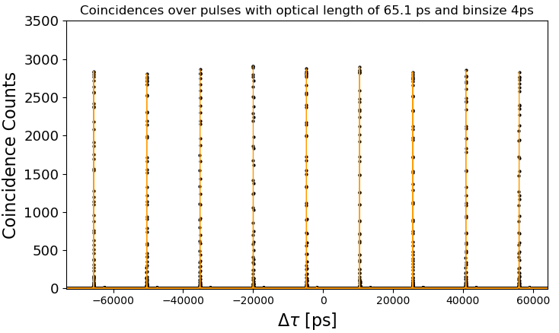
From Timestamps to Coincidences Histograms
.bin file
Relative time between Start & Stop events in ps
Index
Timestamp
Timestamp * Reference clock
Pulse Train From one detector
Detector 1
Detector 2

Slide 8

Seeking Normalization of the counts to achieve g₂($τ$)
Ingredients :

Slide 9
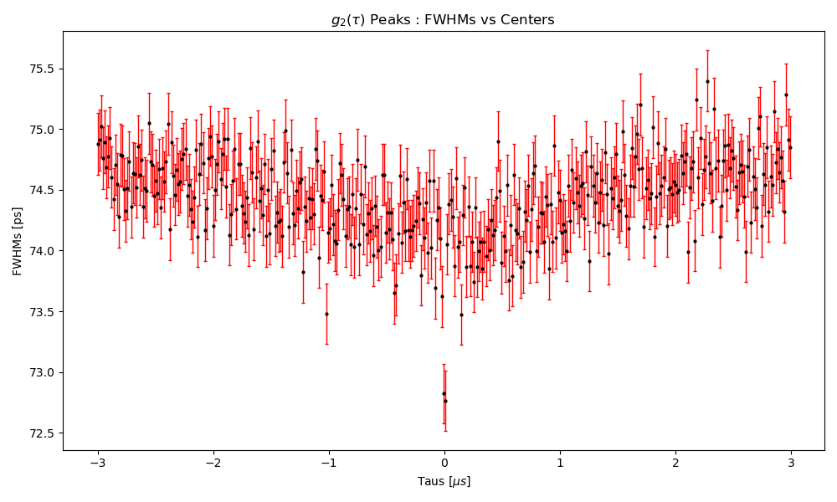
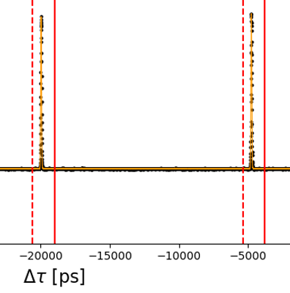
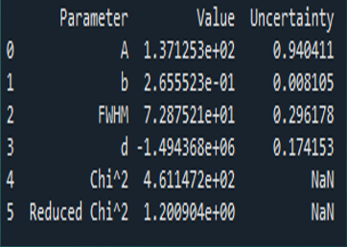


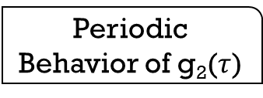
Fitting the peaks in g₂($τ$)
What we need ?
Gaussian fit of every peak
Periodic Behavior of g₂($τ$)
Saving Dataframes of every fit into .CSV files
Periodic Boundaries
$$τ=0$$
SUSPECT NO.1
Offset Correction

Slide 10
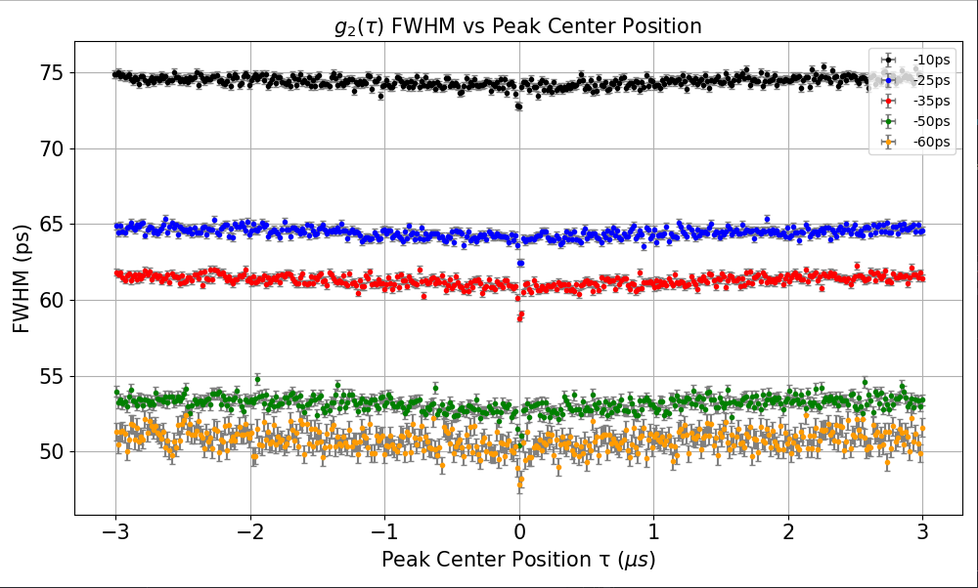

How the pulse length affects the FWHM of the peaks of the g₂($τ$)?
65.1ps
Reduction of the optical length of the pulses
55.5ps
49.8ps
41.4ps
37.2ps

Slide 11
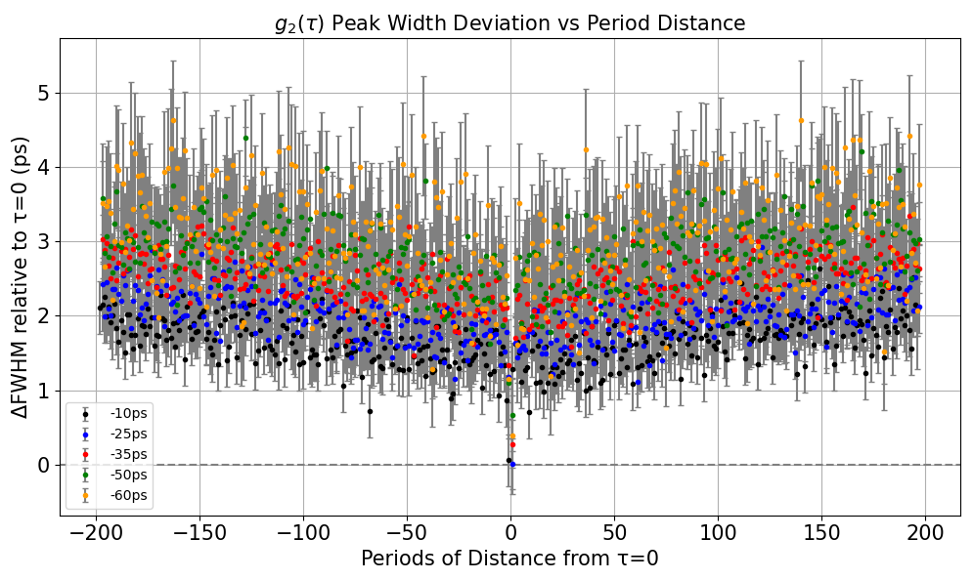

Can We Detect Broadening in g₂($τ$) Peaks via FWHM Variations?
What do I expect ?
Broadening of the Widths with the increase of the distance
What do I get ?
Slight absolute linear increase
Apparently more evident for shorter pulses
Pulse Length
65.1ps
55.5ps
49.8ps
41.4ps
37.2ps

Slide 12
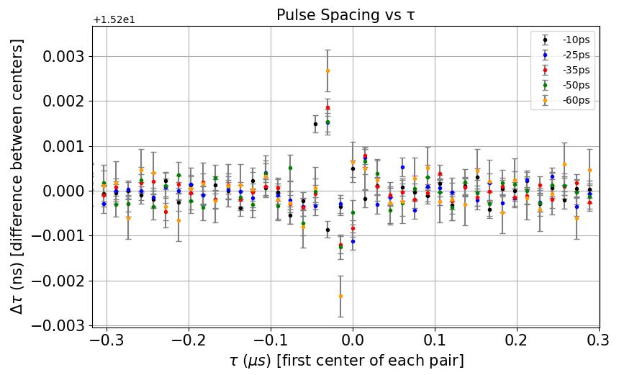
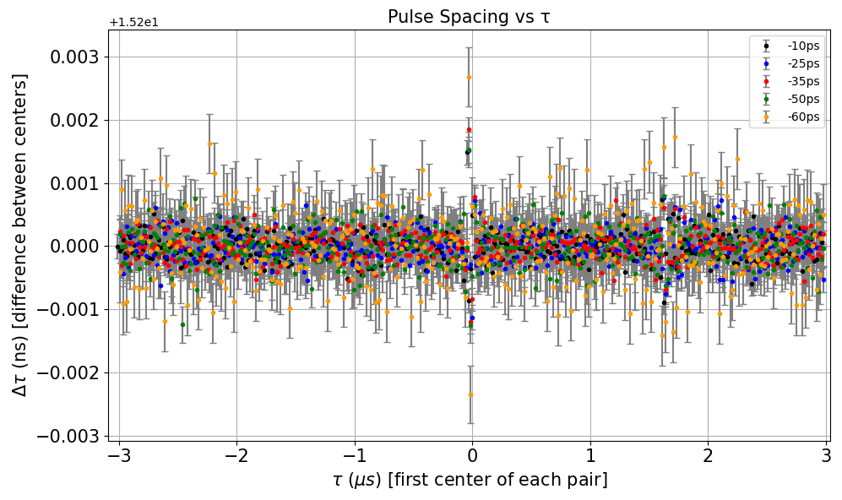
Verifying the stability of the FPGA clock
Extraction of Timestamps already implements this
What do we expect ?
Roughly constant behavior
Pulse Length
65.1ps
55.5ps
49.8ps
41.4ps
37.2ps
Not messing things up
BUT…
Not yet clear behavior near zero

Slide 13
What’s next ?
Obtain the Detector Response function
Allan Variance study on FPGA’s reference clock
Study the impact on Single Photon Indistinguishability

Slide 14
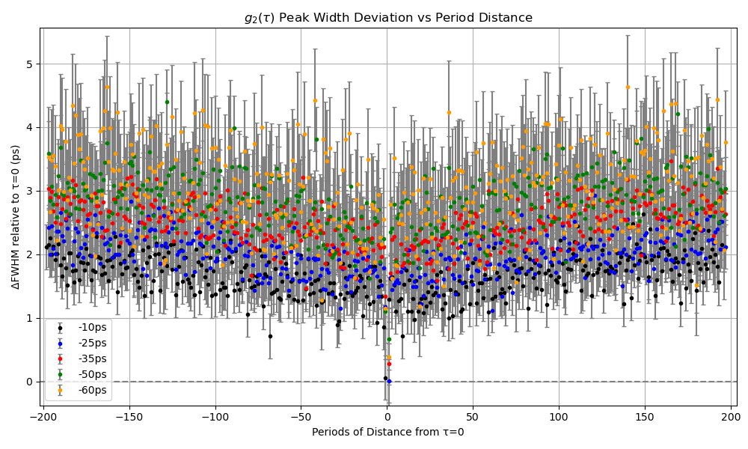
Any Questions ?

Slide 15
How is carried out the Error Propagation ?

